Slide 1
SETTING THE TREND: LIBRARIANS AS LEADERS
JUNE 6, 2019

Slide 2
Travel books for young children:
Why write them?
Why use them in the classroom?

Slide 3
WHY WRITE TRAVEL BOOKS?
To highlight the real life adventures of families and friends.
To inspire families and educators to explore the world in a new way.

Slide 4
WHY USE THEM IN THE CLASSROOM?
To bring imagination and education to the classroom in a unique way.

Slide 5
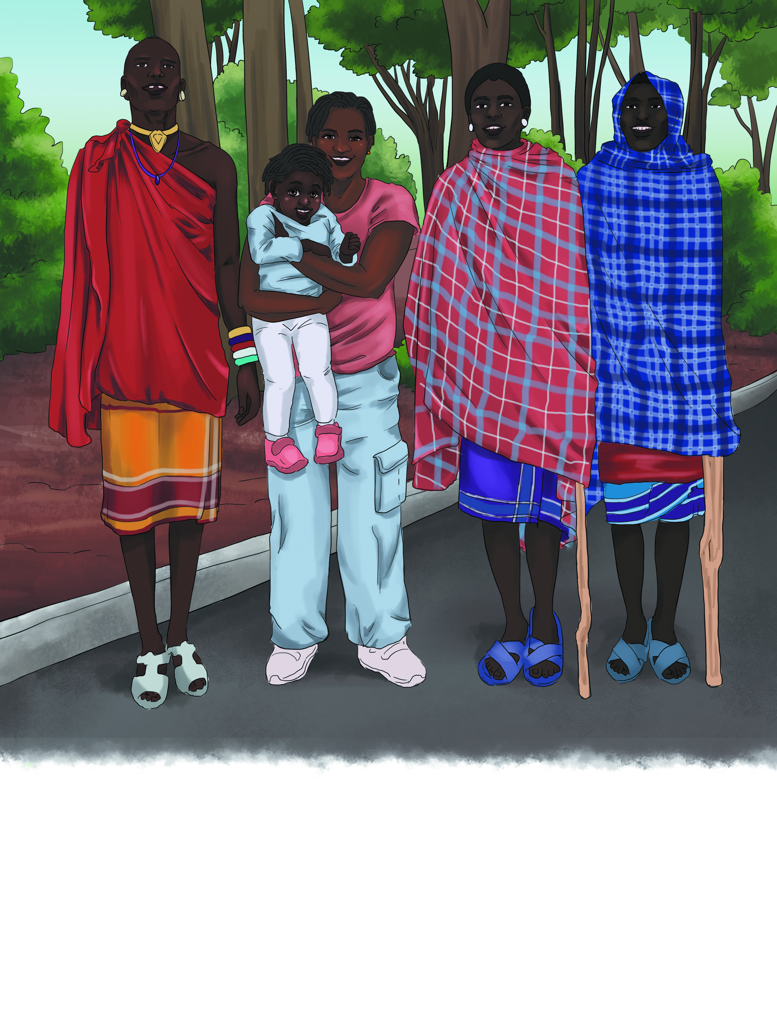
SOCIAL STUDIES
ECONOMICS
What are they known for making?
What toys are popular?
GOVERNMENT
Is there a King or Queen?
Is there a tribal chief?
CULTURE
What are the customs and norms?
What type(s) music do they listen to?
What treats do kids like?
HISTORY
Brought to life
LANGUAGE
“Kia Ora” - Have Life , Be Well!

Slide 6
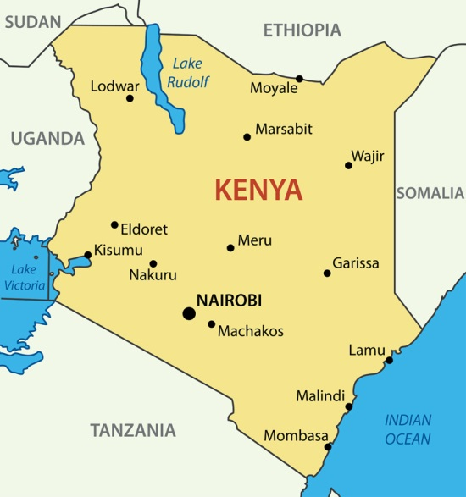
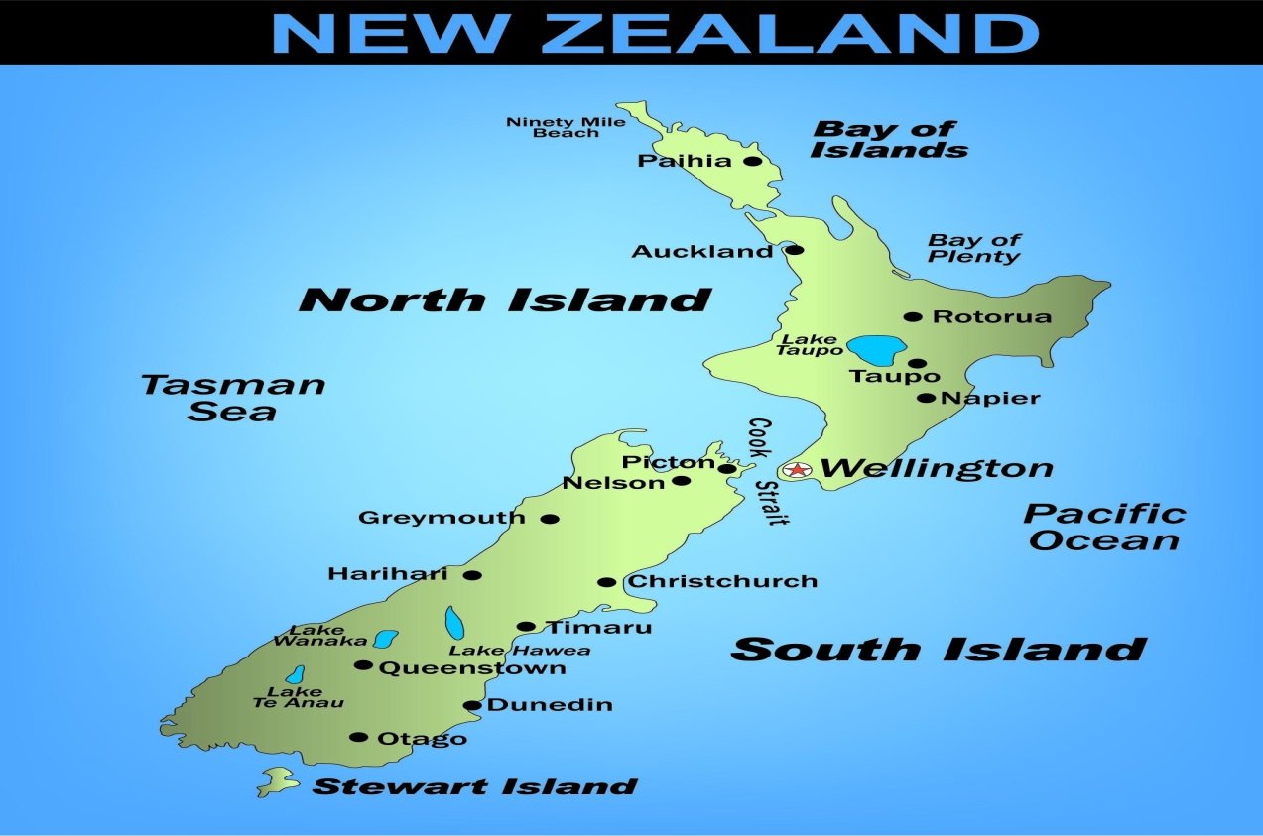
GEOGRAPHY
A cool way to teach about LOCATION and MAPS
Human Geography
Physical Geography

Slide 7
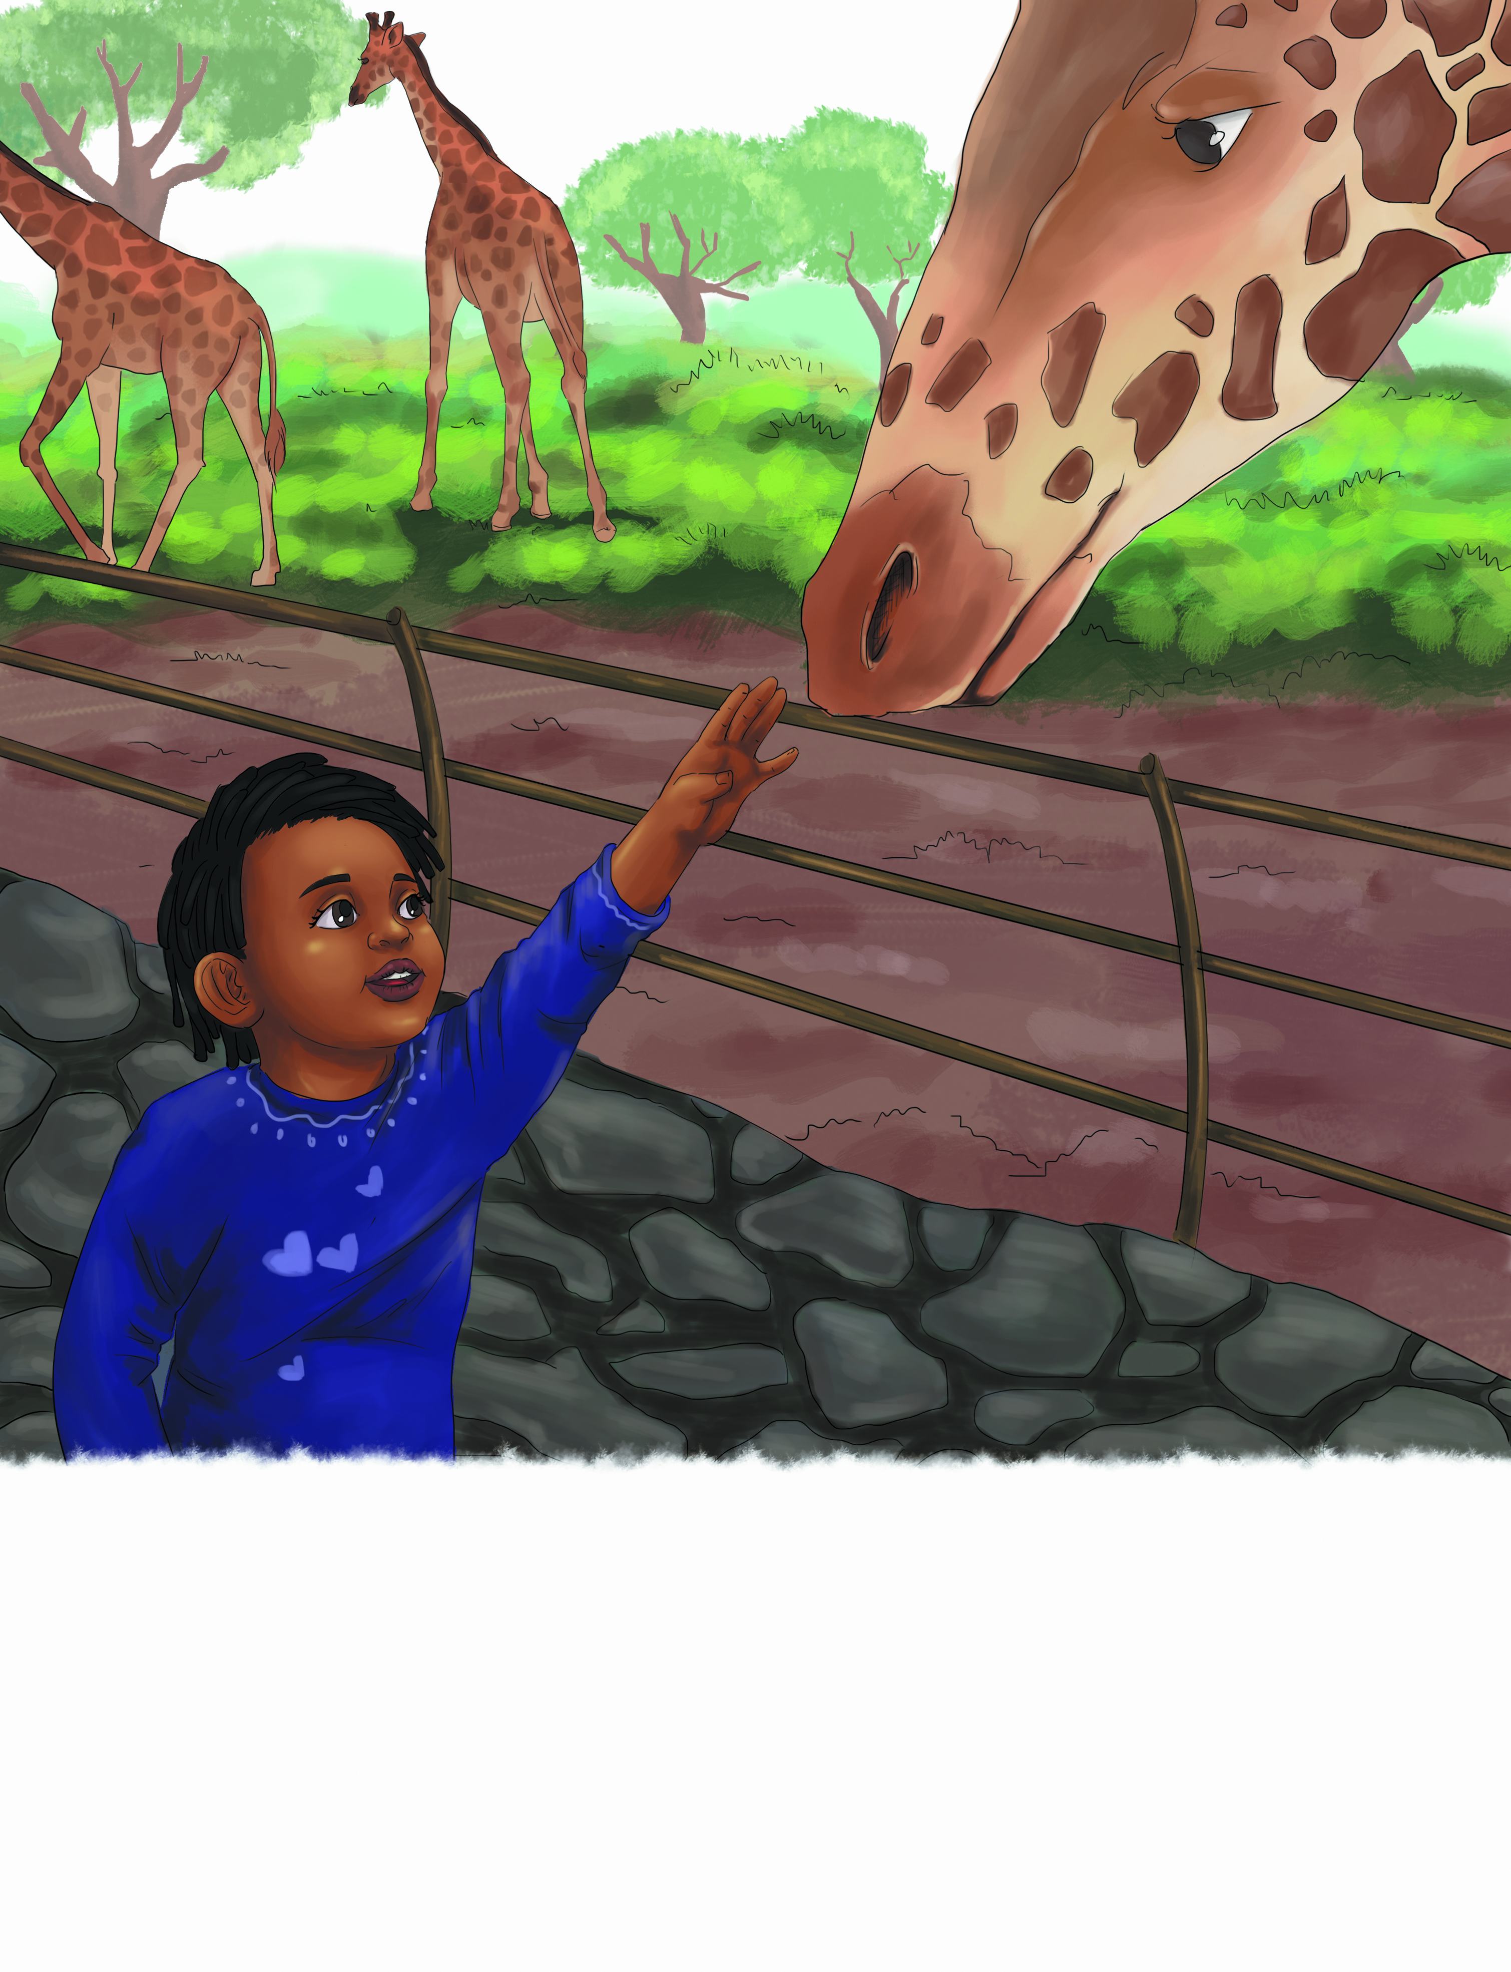
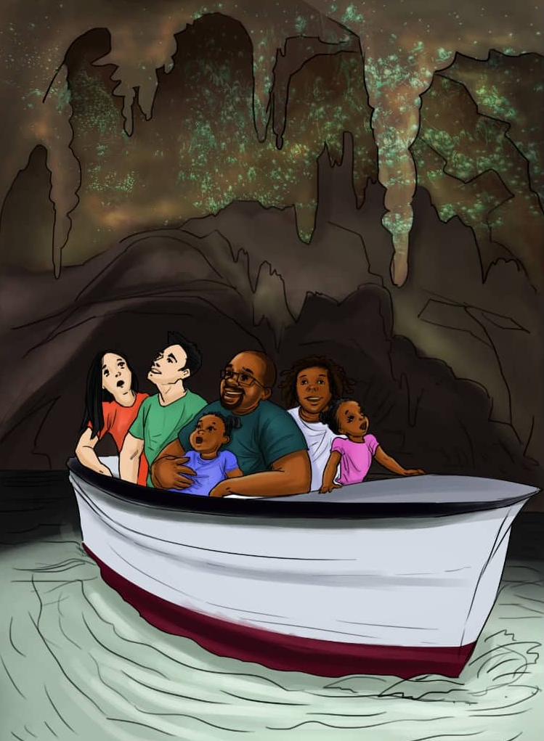
SCIENCE
Animals found only in certain environments
Unique habitats
Giraffe Manor
Kenya
Glowworm cave
New Zealand

Slide 8
MATHEMATICS
Currency conversion
5 EUROs = ? US Dollars
Metrics system vs. Imperial System
Kilometers (km) vs. Miles
Distance
How far away is the gelato shop?
Time Zone Changes
Central (CST) to Eastern (EST)

Slide 9
FOLLOW ME
FACEBOOK.COM/CUPCAKEANDNOODLES
INSTRAGRAM.COM/RAISINGNOMADS
TWITTER.COM/RAISINGNOMADS

Slide 10
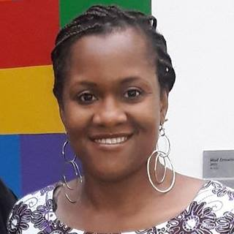
Angie Stubbs, Author
Angiestubbs.com
info@angiestubbs.com
© copyright 2019, Raising Nomads Travel Co.
Author, Agency Stubbs,
All rights reserved.
May be downloaded with credit given to author

